Slide 1
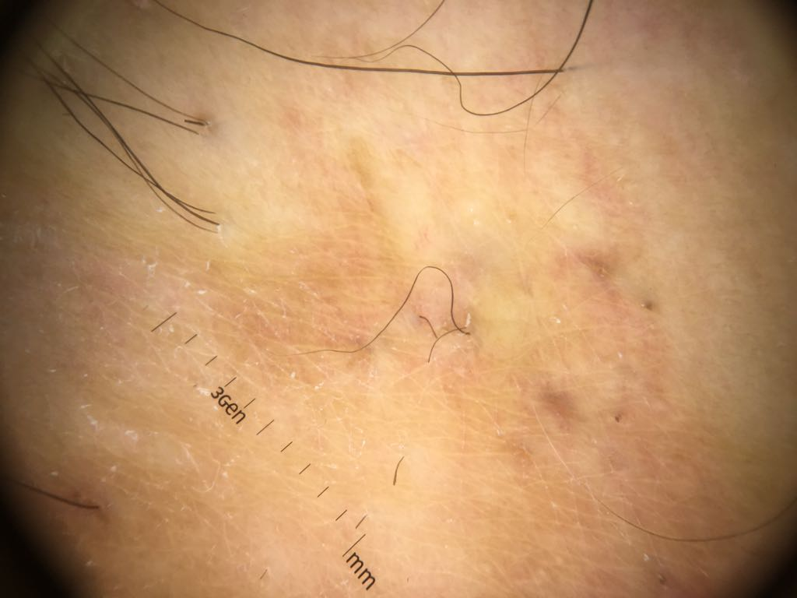
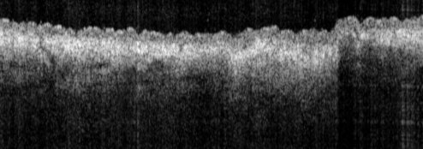
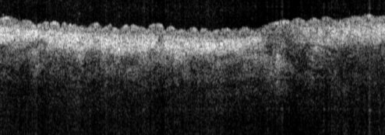
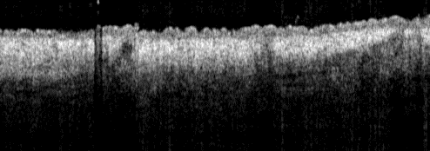
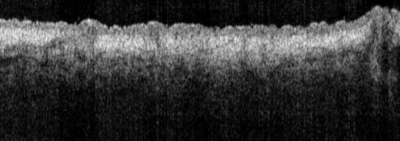
PAOCT, 06/04/2018, male, 30, waist, inflammation, position 1
Maybe lesion area
Photo
Imaging area:
10x10 mm
Position 1
1 mm
OCT
Position 2
Cross-section of structure given by OCT,
video of the whole volume (10x10 mm)
1 mm
Position 3
Tomo, OCT
1 mm
1 mm
Notes:
青斑血管炎['lɪvdɔɪd]

Slide 2
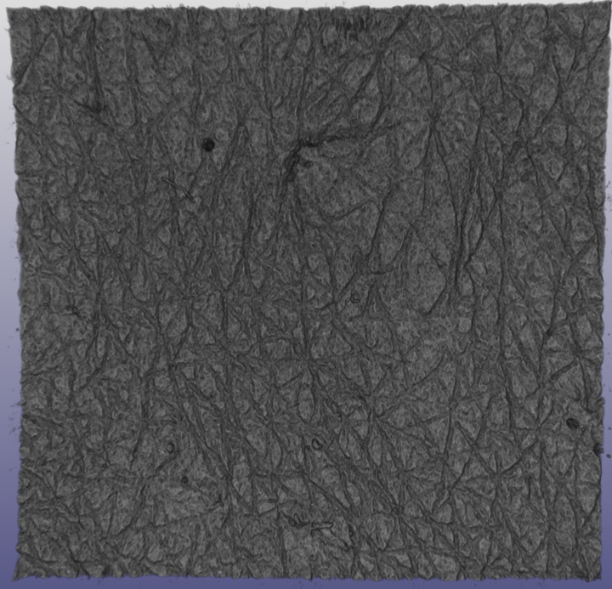
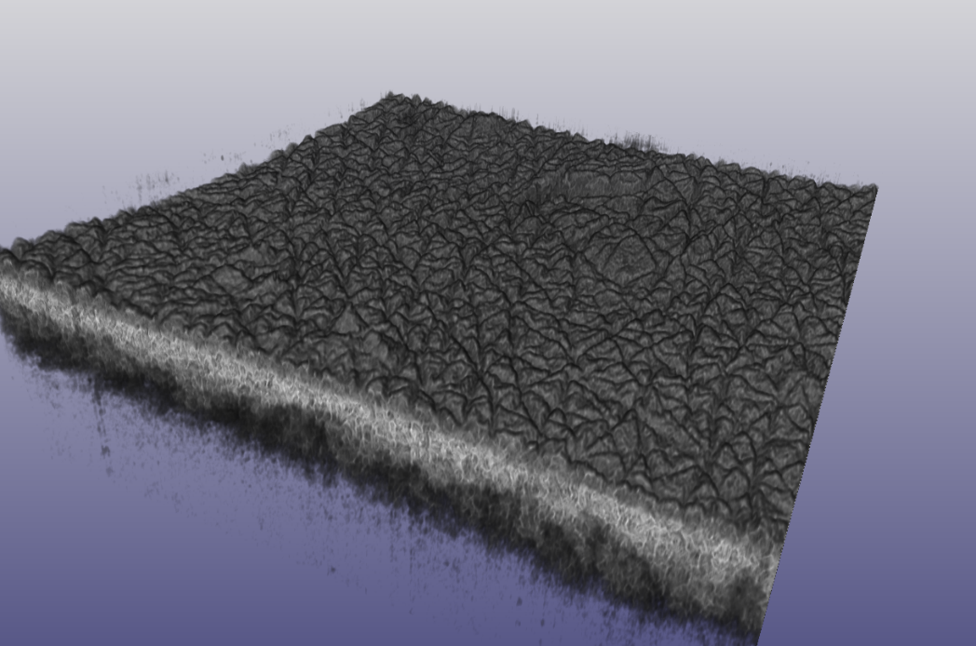
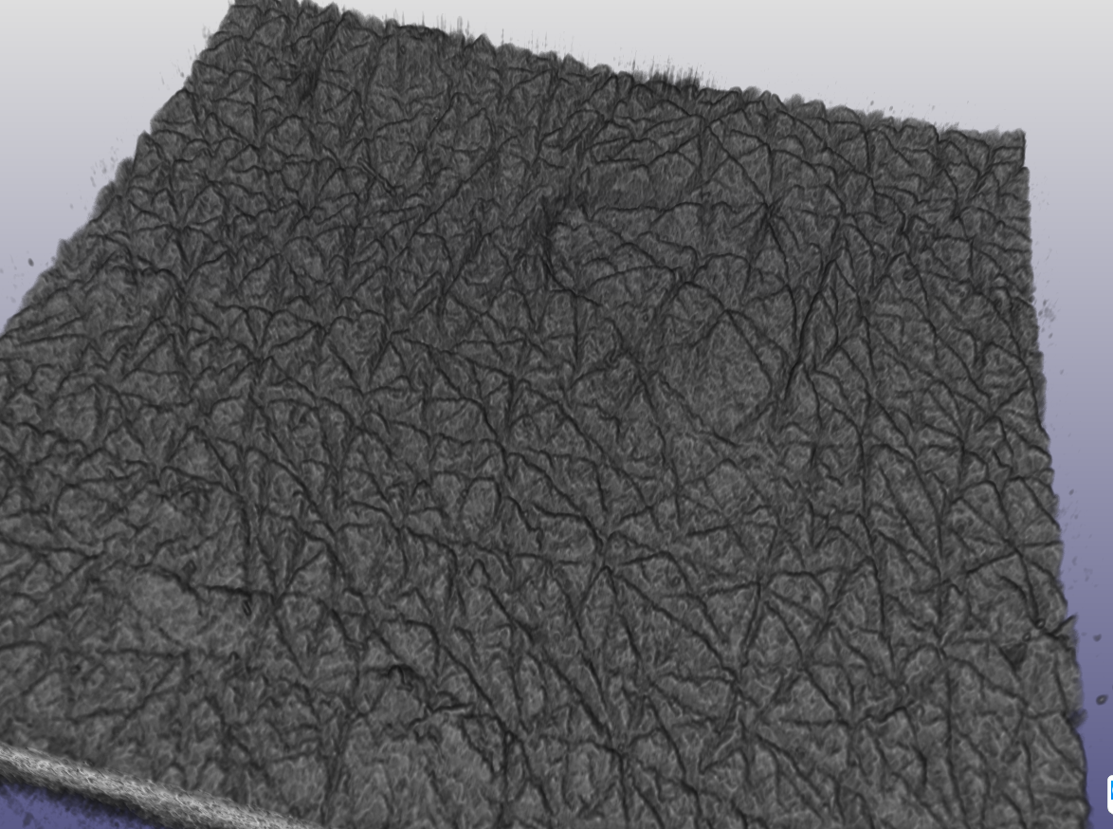
3D rendering of the whole volume
Maybe lesion area
Notes:
青斑血管炎['lɪvdɔɪd]

Slide 3
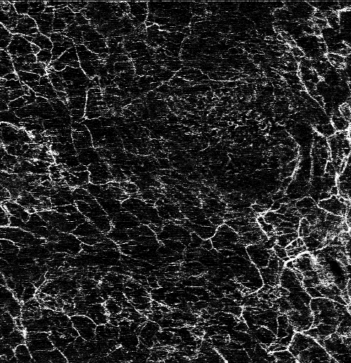
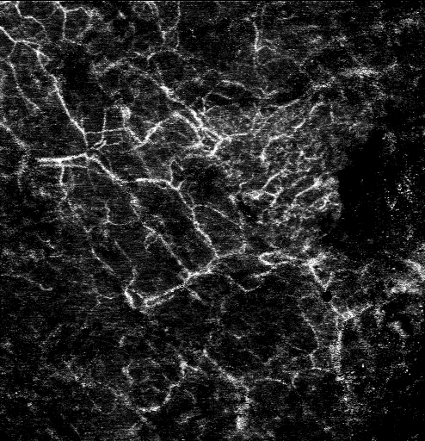
Enface view of capillaries given by OCTA, 10x10mm
0-0.5 mm in depth
0.5-1 mm in depth
Lesion area
Lesion area
1 mm
1 mm

Slide 4
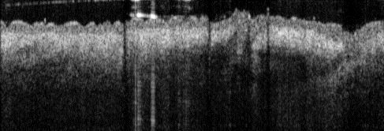
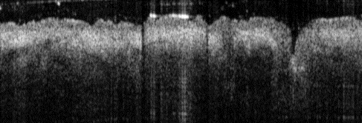
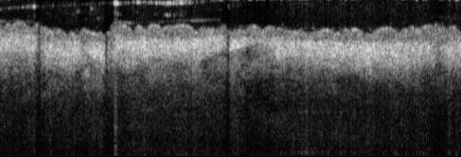
PAOCT, 06/04/2018, male, 30, waist, inflammation position 2
Maybe lesion area
Photo
Imaging area:
10x10 mm
Position 1
1 mm
OCT
Position 2
Cross-section of structure given by OCT,
fly through of the whole volume (10x10 mm)
1 mm
Tomo, OCT
1 mm
1 mm
Notes:
青斑血管炎['lɪvdɔɪd]

Slide 5
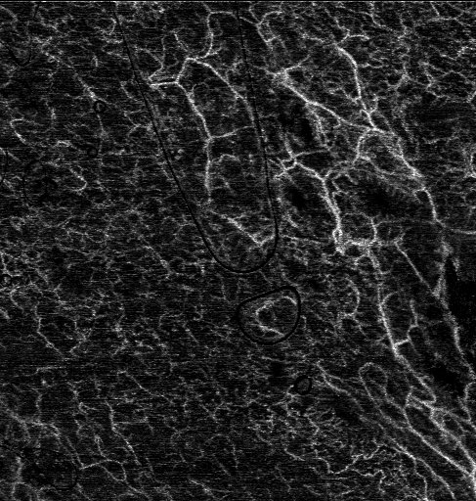
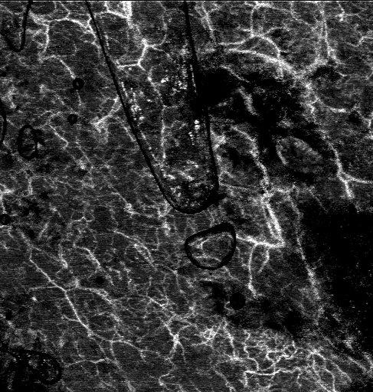
Enface view of capillaries given by OCTA, 10x10mm
0-0.5 mm in depth
0.5-1 mm in depth
Hole like area
Lesion area
1 mm
1 mm

Slide 6
PAT signal is too bad because motion artifact of the breath.

